Slide 1

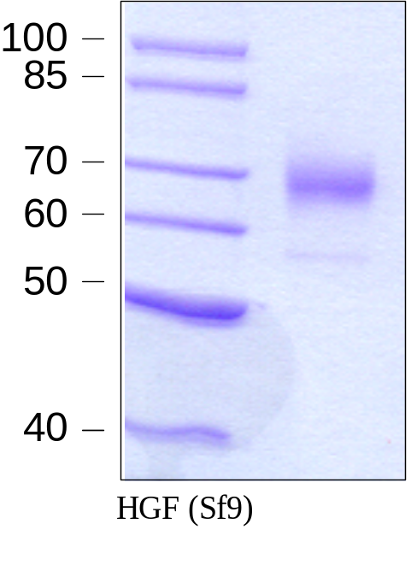
Reliatech GmbH
Recombinant human HGF (Insect cells)
(Cat #300-010 / -011)
Fig. 1: SDS-PAGE analysis of recombinant human HGF. Sample was loaded in 15% SDS-polyacrylamide gel under non-reducing conditions and stained with Coomassie blue.
http://www.reliatech.de / orders@reliatech.de

